Slide 1

Connectors in English
Universidad Nacional Autónoma de México
Escuela Nacional Preparatoria

Slide 2
What is a connector?
Connectors, also called conjunctive words, are words that link two similar elements in a sentence.
They are also called linkers, connectives or linking words, they are the glue that holds your sentences together. A text wouldn’t be a proper text if we didn’t use connectors appropriately. However, this is one of the things that lower-intermediate and intermediate English students struggle with the most. Sometimes, students don’t know an appropriate one to use or they don’t know how to use it properly. For this reason, in this presentation, we will go over some essential connectors.

Slide 3
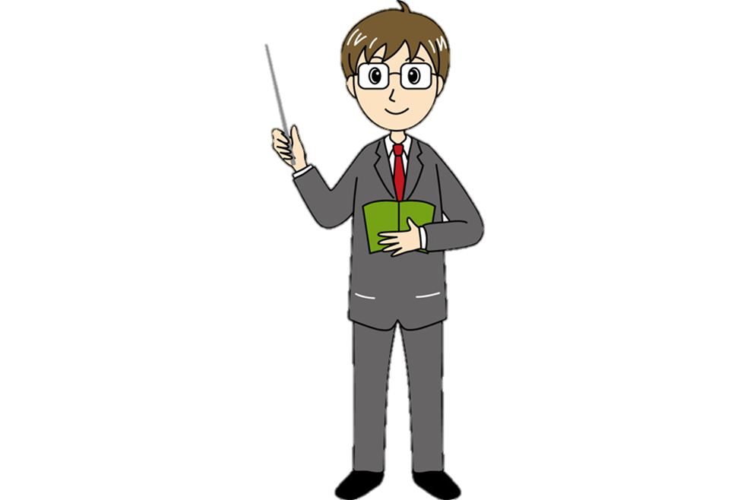
Cause & effect connectors
Connectors are words or groups of words that help us connect words, phrases or sentences. Cause and effect is a relationship between events or things, where one is the result of the others. They are a combination of action and reaction. When we talk about an effect resulting from a certain cause, we use expressions such as:
So
Therefore
As a result
Consequently
Then

Slide 4

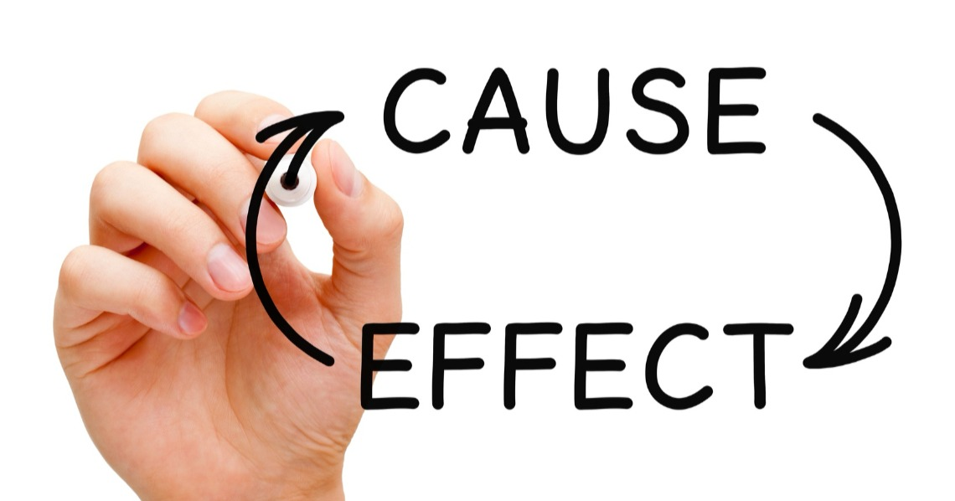
Cause & effect connectors
The cause can be a person, object, situation, or event that can result in something, while an effect is the result of the actions of the person or the outcome of some chain of events that have happened. The cause will in a way explain the reason why the effect happened in the first place. The cause naturally precedes an effect, while the effect will always follow it.

Slide 5
Cause & effect connectors examples
Some examples to use this cause and effect connectors are:
I will not cheat on the English exam, so I will not be punished.
Steven robbed a book from the library, therefore he was expelled from the school.
I cheated on my final English exam, as a result I failed the semester.
Annie was found smoking in the classroom and consequently she was sent to the Principal's office.
Sam and John beat Tom and he ended up in the hospital, then they got suspended for bad behavior.

Slide 6

Let’s analyze one of the sentences to identify the cause and the effect:
The student robbed an exam, therefore he was expelled from the school.
The whole sentence gives a complete idea of a situation. The first part of the sentence is the cause (reason):
The student robbed an exam - CAUSE
And the second part of the sentence shows the result (consequence):
…therefore he was expelled from the school - EFFECT

