Slide 1
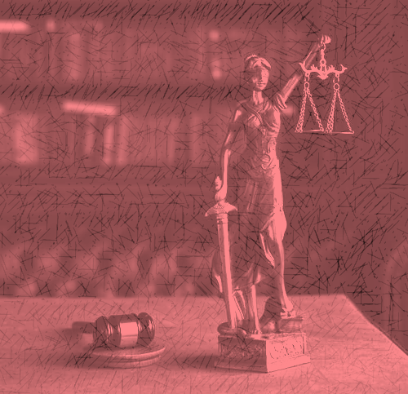
Expository text
“In law, a man is guilty when he violates the rights of others. In ethics, he is guilty if he only thinks of doing so” (Immanuel Kant).

Slide 2
What is an expository text?
An expository text or informational text is a clear and organized written composition.
Its general objective is giving information.
It can also provide facts, expose the truth, explain a topic, give details about a subject or present problems and solutions to a problem.

Slide 3
Types of expository text.
The most common types of expository texts are description, cause and effect, problem and
solution, and comparison.

Slide 4
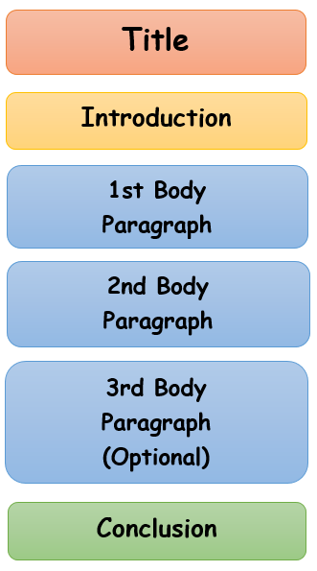
Structure

Slide 5
Title and introduction
The title gives a general idea of the contents of the text.
The introduction mentions the main topic of the text, the objective of the text and gives a glimpse of the information that will be explained in the following paragraphs.

Slide 6
Body
Paragraphs present, in a logical order, all the ideas and information you have about the main topic. These paragraphs may contain 2 or more sentences that provide: examples, definitions, details, research, historical background, illustrations, photos, quotes, etc.
In a paragraph, an indentation is the space between a margin and the text.

Slide 7
Conclusion
Summary of the most important ideas previously mentioned.
Author’s opinion on the topic and reasons to support that opinion.

Slide 8
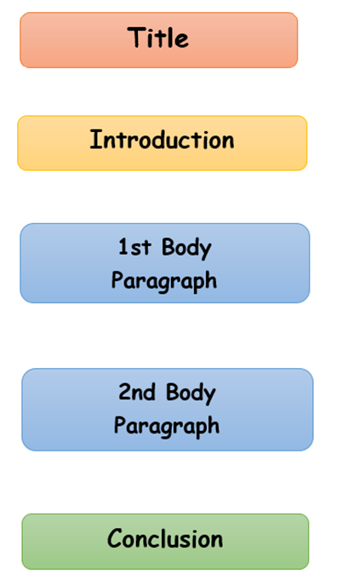
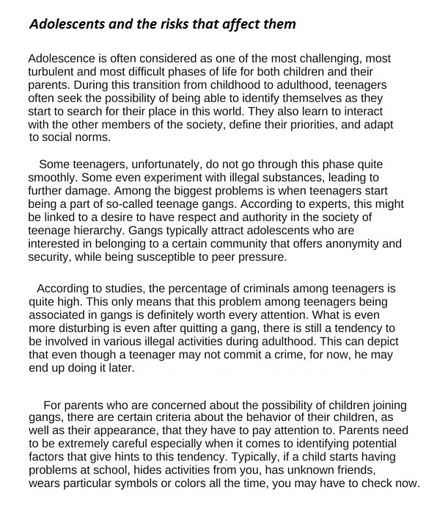
Text example
Text adaptation from How To (Do) PROBLEM SOLUTION ESSAY Matters Without Leaving Your Working Environment (Household ). Law firm Azad & Company. Retrieved on May 25th, 2021. https://azadncompany.com/ho-to-do-problem-solution-essay-matters-without-leaving-your-working-environment-household/

Slide 9

I hope this material was useful for you!

