Slide 1
First Conditional
In law, a man is guilty when he violates the rights of others. In ethics he is guilty
if he only thinks of doing so. (Immanuel Kant)

Slide 2
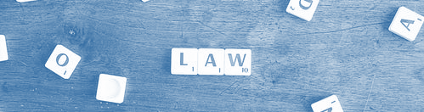
When do we use the first conditional?
The first conditional is a combination of ideas you can use to mention a real present situation -or event- and its possible future results, consequences and/or outcomes. In law and ethics, we apply the first conditional to reflect on the consequences of our actions.

Slide 3
How do I write a first conditional phrase?
The first conditional is formed by using two clauses (full ideas or sentences) and the conjunction “if”.

Slide 4

First conditional structure
If + present, (present event, situation or “condition”)
future sentence “will, can, might or going to”
(possible result)

Slide 5
Examples
If + present
future (will, can, might, going to)
1) If you drink and drive, 2) If you use drugs,
3) If you don’t study for the exam,
4) If you break the law,
you can get into an accident.
you might get very sick for the rest of your life. you will fail.
there are going to be severe consequences.

Slide 6
TIPS
It is possible to change the position of the clauses. But be very careful! To change the position, you have to change the complete clause/idea, you cannot change the inner elements of the clause.
✓ If you see someone cheating on the exam, will you tell the teacher? ✓ Will you tell the teacher if you see someone cheating on the exam?
🗴Will you see someone cheating on the exam, if you tell the teacher?
🗴 if you tell the teacher, Will you see someone cheating on the exam?

Slide 7
Remember: The “if” clause always uses the present tense. The results or consequences use a future form or a modal verb of possibility.

Slide 8
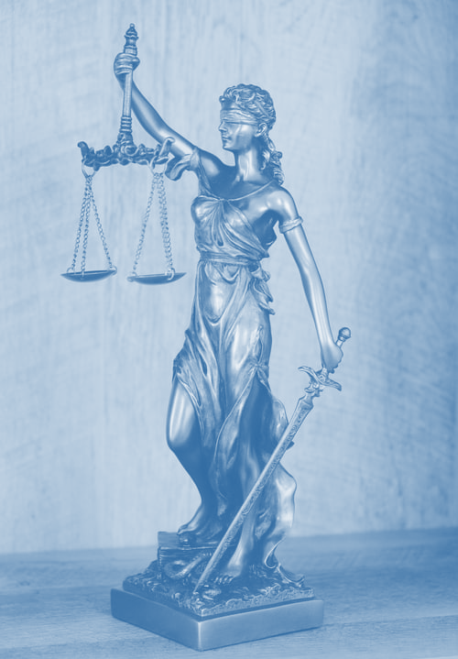
Let’s see some more examples:
In some states of the USA, if teenagers drink in a house “supervised” by adults, these adults can be criminally charged for contributing to the delinquency of minors.
Also, if an adolescent sends or distributes “hot” videos or nude pictures of other minors, he or she will be charged with child pornography and end up registered as a sex offender.
Bullying laws and regulations vary by state and jurisdiction but many states have school sanctions for cyberbullying and electronic harassment. This means that if students commit bullying or cyberbullying against a school member, they are going to be expelled from the school or even receive criminal penalties.

Slide 9
Think:
there’s a third World War?
you or your friends commit a crime?
you are caught cheating on a test?
you don’t pass your English exam?
one or your friends gets pregnant?
What do you think will/can happen if…

Slide 10
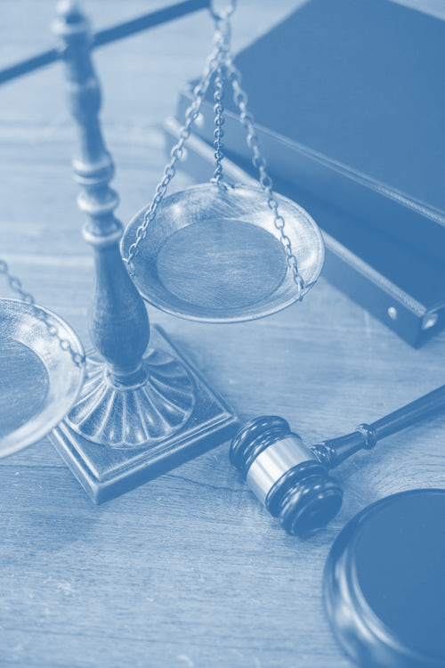
I hope this material was useful for you!

