Slide 1
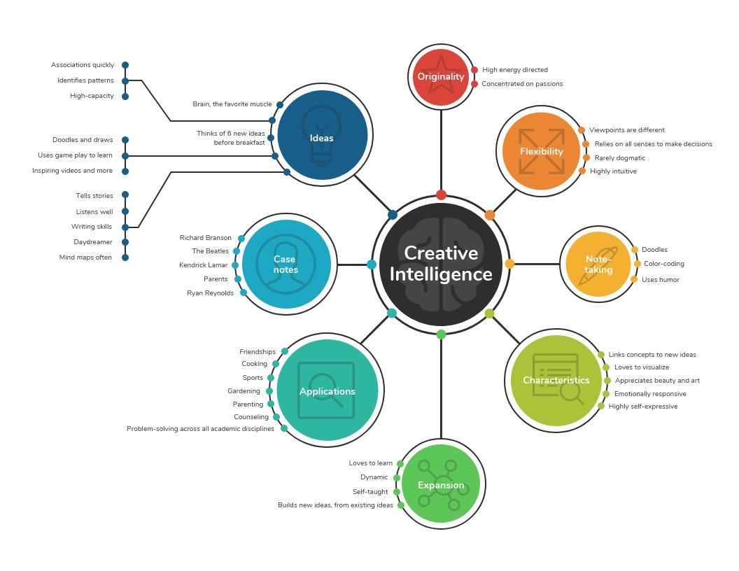
“CONCEPT MAPS”

Slide 2
Purpose
Concept maps are drawings or diagrams used to help students organize and represent knowledge of a subject.

Slide 3
Structure
Concept maps begin with a main idea (or concept) and then branch out to show how that main idea can be broken down into specific topics.

Slide 4
Use
Use concept maps to help any individual or group to describe their ideas about some topic in a pictorial form. ...
It useful for helping social researchers and research teams develop and detail ideas for research.

Slide 5
5 easy steps for drawing a concept map
Select a drawing medium. ...
Create a main concept. ...
Identify key concepts. ...
Organize shapes and lines. ...
Fine-tune the map.

