Slide 1


Slide 2
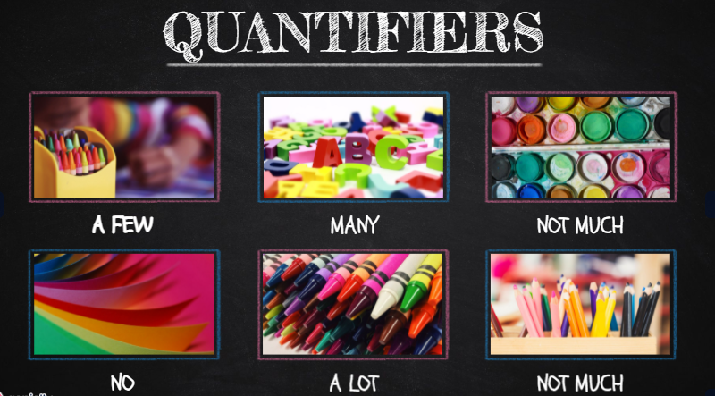

Slide 3

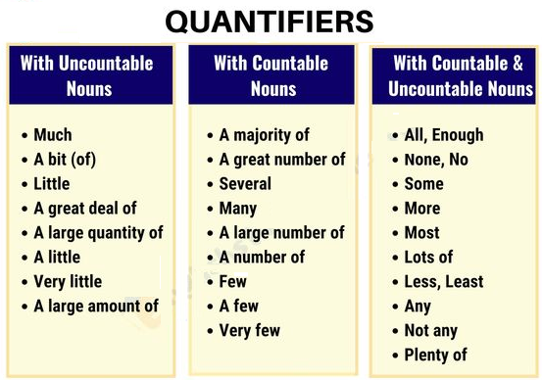
We use quantifiers when we want to give someone information about the number of something:
Example:
Most children start school at the age of five.
We ate some bread and butter.
We saw lots of birds.

Slide 4
References
Learn English. (2021). Quantifiers. Tomado de: https://learnenglish.britishcouncil.org/english-grammar-reference/quantifiers

