Slide 1
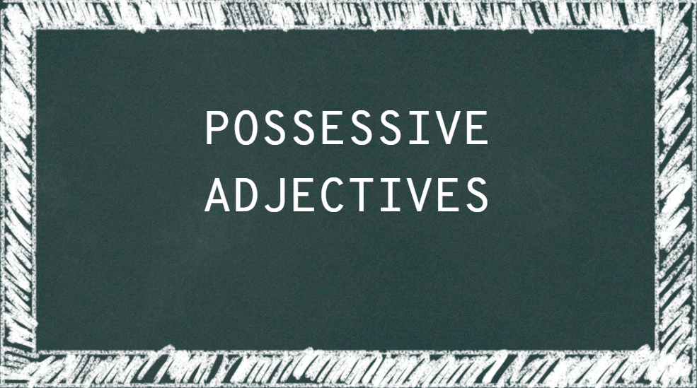

Slide 2
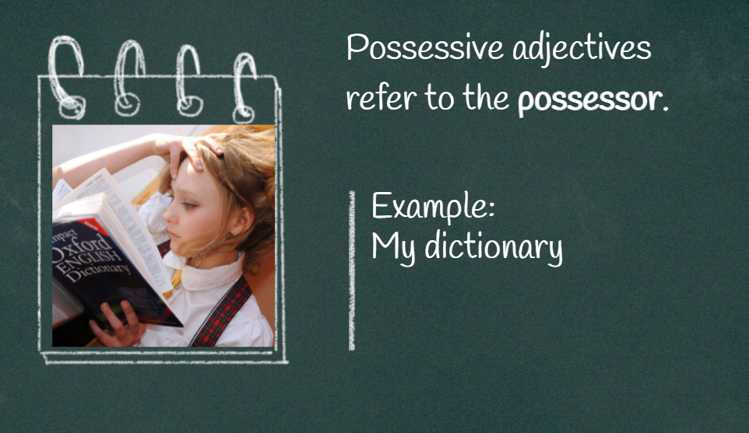

Slide 3

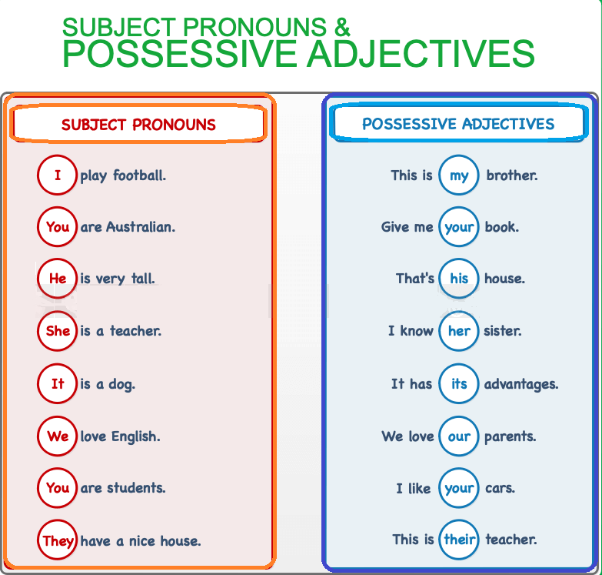

We use:
Subject pronouns + verb + possessive adjectives + noun
Adjectives in English have no plural form.
Possessive adjectives are always singular.
These are their apples. (NOT theirs apples)
Possessive adjectives and subject pronouns. (2016). Test-English.Com. https://test-english.com/explanation/a1/possessive-adjectives/

Slide 4
Examples:
Anne likes your hat.
(The possessive adjective "your" sits before the noun "hat" to tell us who owns it.)
I think her job as an accountant is awesome. She is my best friend.
(The possessive adjectives "her" and "my" are sitting before the nouns “job" and “best friend" to tell us who owns them.)
“Men are like steel. When they lose their temper, they lose their worth”
Can you identify the possessive pronoun in the last quote?

Slide 5
References:
UNAM. (2017). Tomado de: https://avi.cuaed.unam.mx/repoUAPA. Possessive Adjectives. https://avi.cuaed.unam.mx/repositorio/moodle/pluginfile.php/3001/mod_resource/content/15/Contenido/index.html

