Slide 1


Slide 2
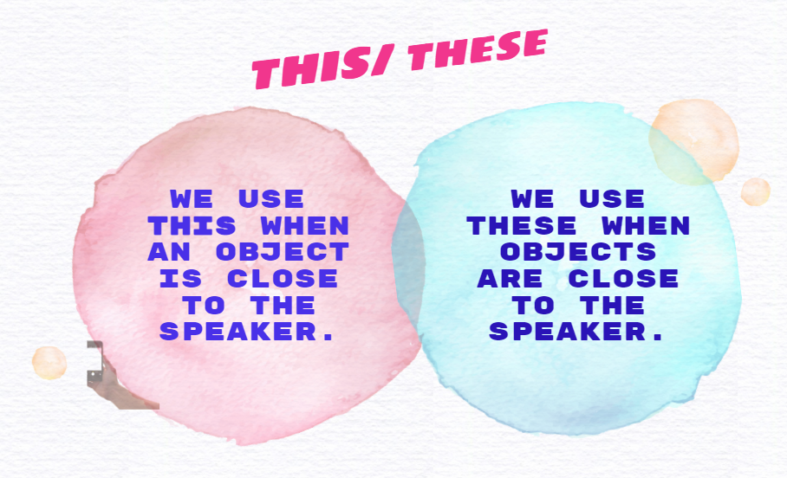



Slide 3


Slide 4

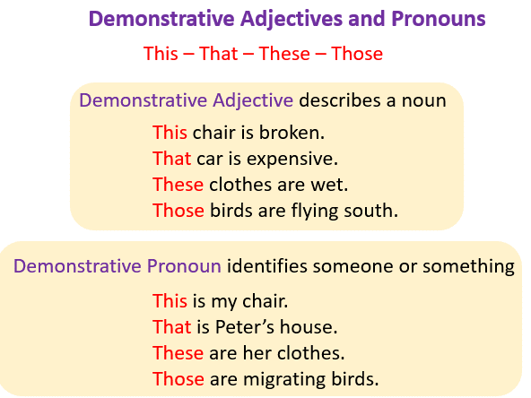
Examples:
Demonstrative Adjectives (examples, solutions, videos). (2005). Www.Onlinemathlearning.Com. https://www.onlinemathlearning.com/demonstrative-adjectives.html

