Slide 1
English IV
Teacher: Yolanda Gabriela de la Llata Dohrman
UNit1: introducing yourself and others

Slide 2
VERB “TO BE”
AFFIRMATIVE FORM NEGATIVE FORM INTERROGATIVE FORM
I + AM … I´M + NOT… AM + I …?
HE/SHE/IT + IS … HE/SHE/IT + ISN´T… IS + HE/SHE/IT… ?
WE/YOU/THEY + ARE … WE/YOU/THEY + AREN´T … ARE + WE/YOU/THEY….?

Slide 3
USES of verb “to be”:
NAME : My name is… I´m……
*AGE: I´m 15 (years old)
NATIONALITY: (I´m Mexican/ I´m from Mexico
OCCUPATION: (I´m a highschool student)
PHYSICAL DESCRIPTION( HEIGHT, WEIGHT, SKIN COLOR)
PERSONALITY: (I´m medium height, slim, brunette and shy.)
LOCATION (ESTAR) EJ. I am at home/school…

Slide 4
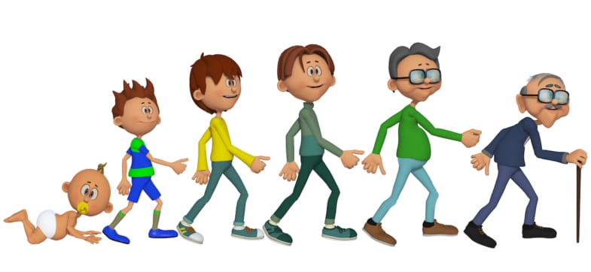
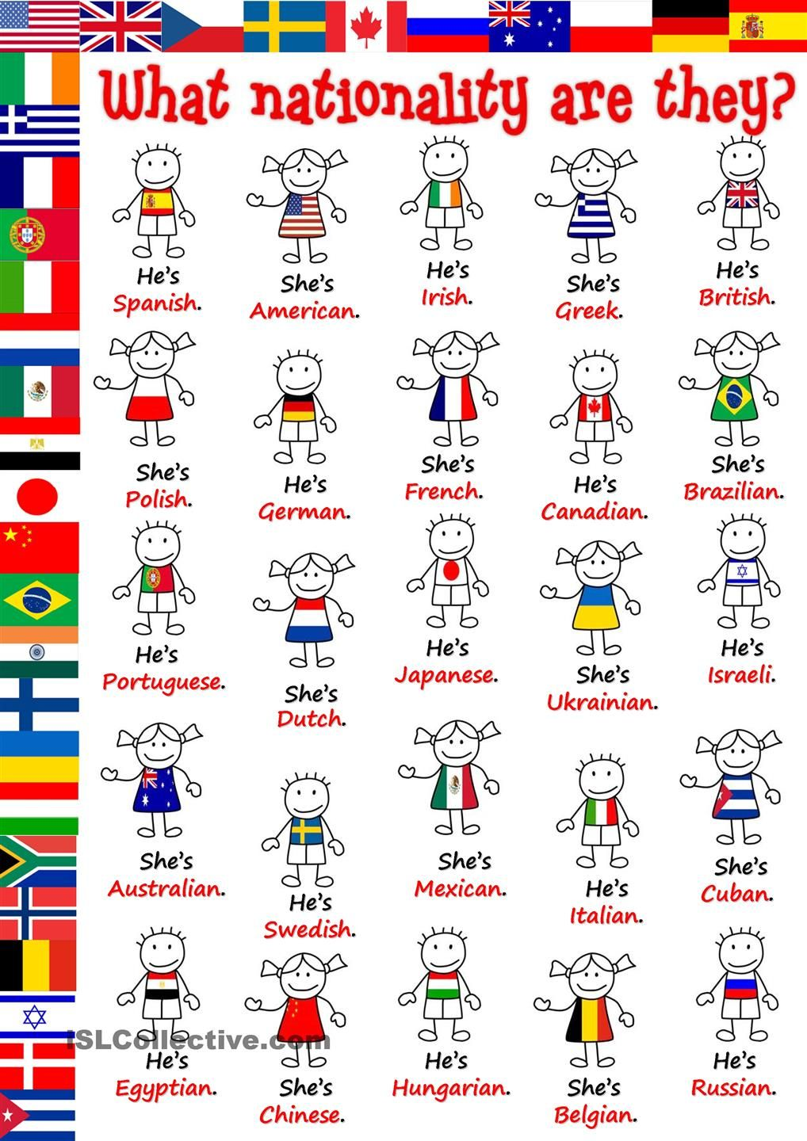
NAMES: PEDRO, CARLOS, MARIO,ETC.
AGE: BABY, TEENAGER, YOUNG MAN, MIDDLE AGED MAN, OLD MAN
NATIONALITIES

Slide 5
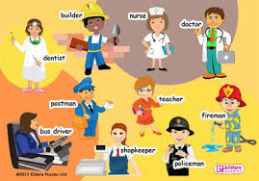
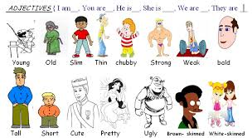
PROFESSIONS AND JOBS
ADJECTIVES RELATED TO PHYSICAL APPEARANCE

Slide 6
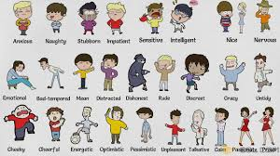
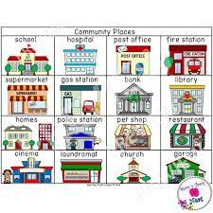
PERSONALITY ADJECTIVES
PLACES

Slide 7
PHRASES TO INTRODUCE YOURSELF AND OTHERS:
A: Hi , my name is Sofía. Nice to meet you!
B: Nice to meet you too! I´m Carlos. Where are you from?
A: I´m Mexican and you? (I´m from Mexico)
B: I´m American. Let me introduce you to my friend Laura. She is from Mexico too.
A: Nice to meet you Laura. How old are you?
B: I´m 15 (years old). NEVER: I HAVE 15…
A: Oh, me too! Are you in high School?
B: Yes, I´m a high school student.
A: You´re very nice and friendly. I hope to see you soon. Bye!

Slide 8
Practice with a guessing game:
https://www.youtube.com/watch?v=2eu18kkdZNg
YOU CAN PRACTICE MORE HERE: www.Games4esl.com

