Slide 1
Present Continuous for Future
NOTION | Describes temporary activities
MEANING | It implies intention, planning and arrangements.
USE | We use it to talk about future arrangements or plans that have been organized.

Slide 2
Affirmative Form
Subject | Verb Be | Ing verb | Time expression
He She It I You We They | Is + am + are + | watching whales in Los Cabos watching whales in Los Cabos watching whales in Los Cabos | tomorrow at 10:00 a.m.

Slide 3
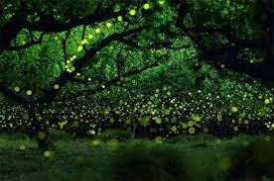
Example:
I am observing fireflies in Tlaxcala tonight.

Slide 4
Negative Form
Subject | Verb Be + not | ing verb | Time expression
He She It I You We They | is not / isn’t + am not / ’m not + are not / aren’t + | watching whales in Los Cabos watching whales in Los Cabos watching whales in Los Cabos | tomorrow at 10:00 a.m. tomorrow at 10:00 a.m. tomorrow at 10:00 a.m.

Slide 5
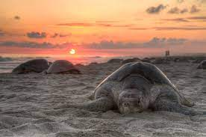
Example:
She isn’t watching turtles in Oaxaca this weekend.

Slide 6
Question Form
Wh Question | Verb Be | Subject | Ing verb | Question mark
What time When Where Who How long | is + am + are + | he she it I you we they | leaving on your trip to watch whales | ? ? ?

Slide 7
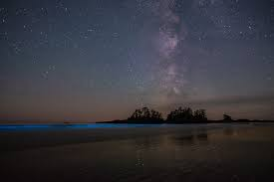
Example:
Where are you travelling tonight?
Why don’t you wait for tomorrow morning?

Slide 8
References
https://www.bbc.co.uk
https://www.learnenglishkids.britishcouncil.org
https://dictionary.cambridge.com

