Slide 1
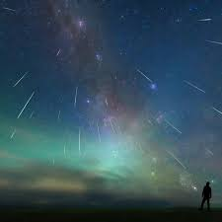
The Simple Present for Future

Slide 2
Use the Simple Present to describe unavoidable events in the future.
According to https://www.timeanddate.com/ the next moon eclipse is on December the 4th.

Slide 3
Affirmative Sentences in the
Simple Present Tense
Subject | Verb | Complement
I / You / We / They | see | the Full Moon in January next year.
He / She / It | sees | the Full Moon in January next year.

